Slide 1
Can We Predict Success Of English Tutors On The Preply Platform?
Final project in the "Introduction to Research Sciences" course
Guy Mizrahi & Eden Tzagai
Lecture: Dr. Jonathan Schler

Slide 2
introduction
The purpose of this study is to examine the feasibility of predicting the success of English tutors on the Preply platform.
We have opted to focus on this particular topic due to its potential to enhance educational outcomes and assist students in finding the most fitting tutors and thereby improving their learning experience.

Slide 3
Data sources and acquisition
We used the Website www.preply.com
Trough Crawling, we extracted the links to each tutor page and then the desired data of each tutor
On the Preply platform, there is a comprehensive list of online English tutors. Each page contains profiles of 10 tutors, with approximately 1500 pages in total.
Our Scraper systematically navigates through each page, accessing individual tutor profile cards, and extracts the necessary information.
To ensure data integrity and as a precautionary measure against potential failures, our system periodically saves the current information onto a CSV file after processing every 100 tutors.

Slide 4
Our dataset is made of the following columns:
Name: The name of the tutor
Country: The tutor's country of origin
English Level: The level of English proficiency of the tutor
Price: The specified fee for tutoring services
Diploma: The educational degree accredited by the website
Certificate: The certification recognized and approved by the website
Response Time: The average time taken by the tutor to respond
Number Of Lessons: The total number of lessons conducted by the tutor.
Stars: The rating awarded to the tutor based on student feedback
Reviews: The number of reviews received by the tutor.
Popularity Score: This column is not currently available on the website but is necessary for calculating the average score derived from the combination of star ratings and reviews.

Slide 5

About the site
Preply is an online platform that facilitates global connections between students and tutors

Slide 6


Slide 7




Slide 8
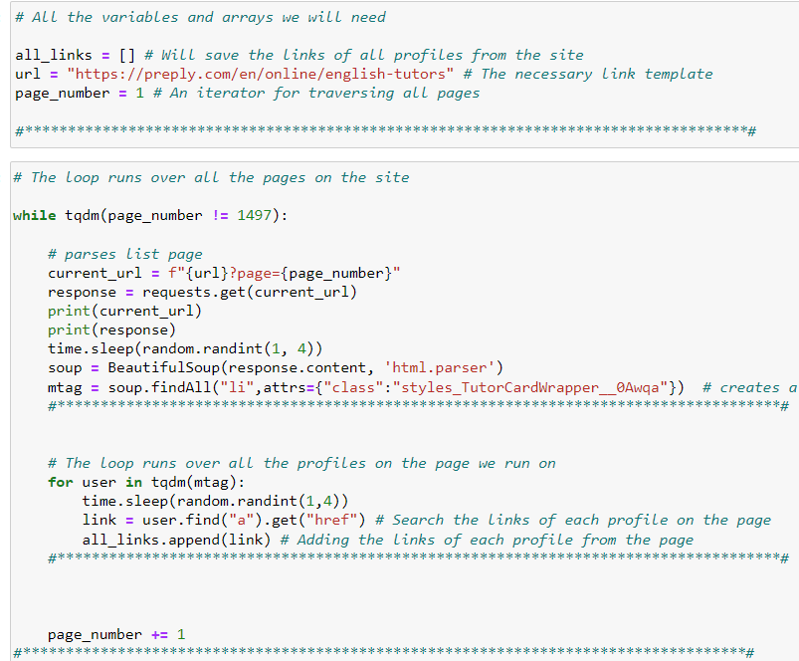
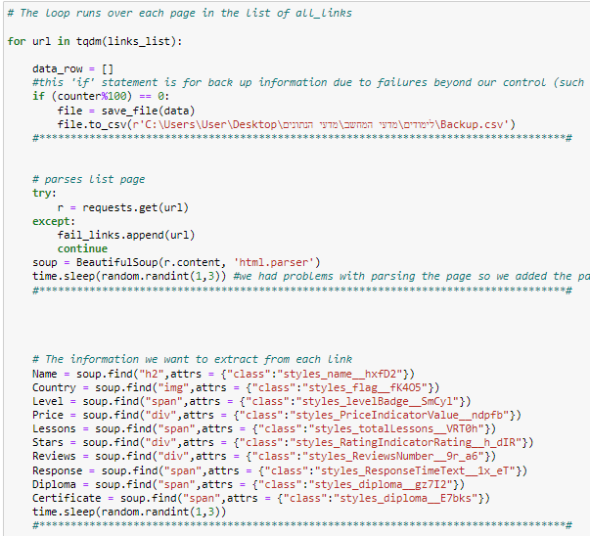
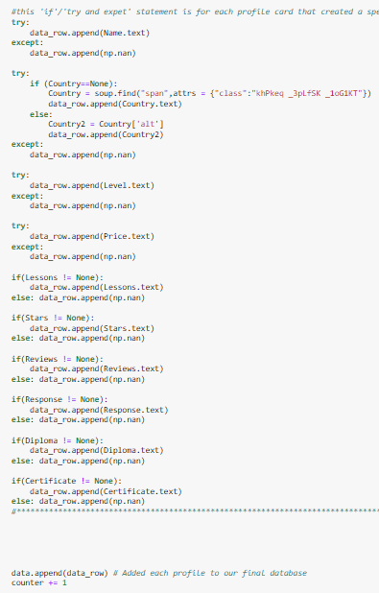

Slide 9
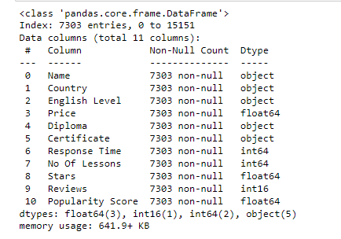
Data Handling:
During a preliminary examination of the dataframe, several issues have been identified within the columns. Specifically, there are 3621 rows that appear to be duplicated or replicate
we have made the decision to update the parameters within the "Diploma" and "Certificate" columns of the dataset
"Response Time" column - certain teachers provide specific time values, while others express approximate times using textual descriptions. we have converted these textual representations into numerical values.
Handling columns with comma-separated values
Managing 'NaN' entries: To ensure data completeness and reliability, we diligently addressed the presence of 'NaN' values by removing them from the dataset.
Convert columns to numeric types

Slide 10
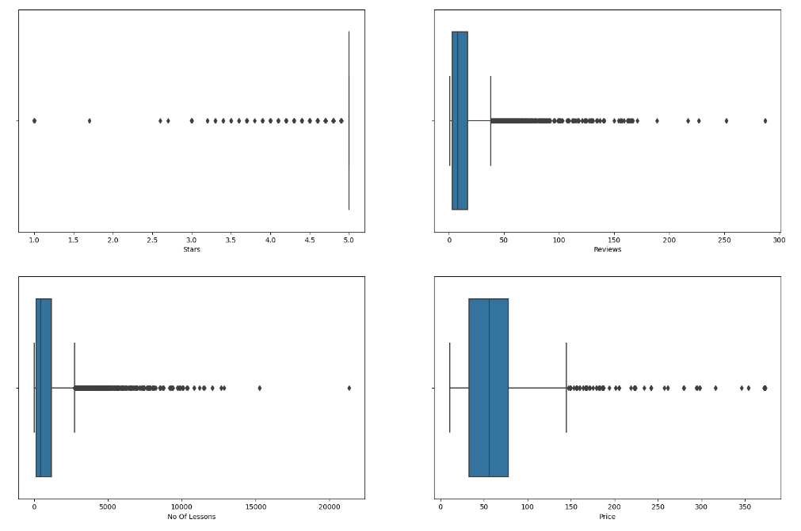
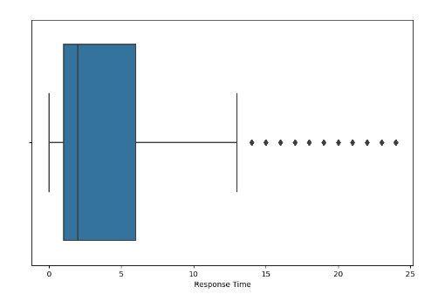
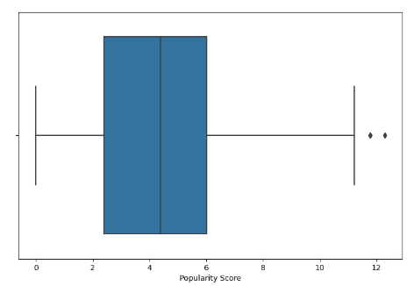
Exploratory Data Analysis
We have generated a boxplot graph that represents all the columns in our dataset. This visual representation allows us to identify and analyze any anomalies or outliers present in the data

Slide 11
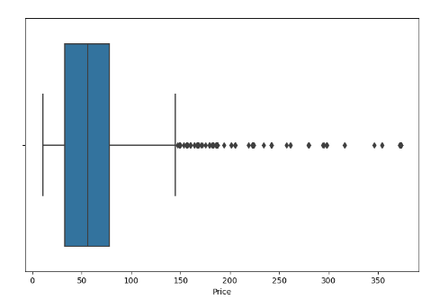
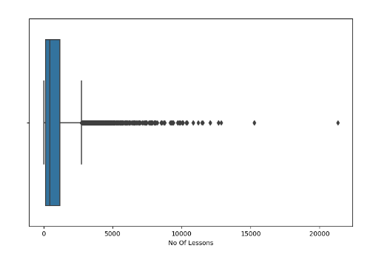
About the site
After observing the boxplots, we identified outliers in the "Price" and "Number of Lessons" columns
we proceeded to handle these outliers using appropriate techniques
However, during step 4, we observed that our machine learning model yielded better results when we excluded the outlier handling step.

Slide 12
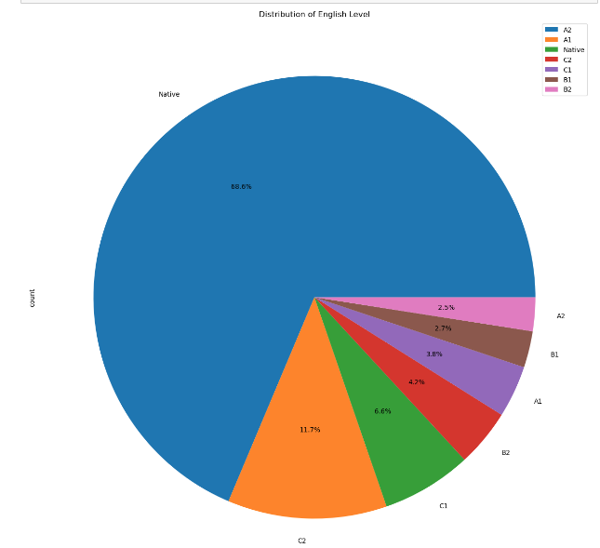
Graph #1
We have created a pie chart to visually represent the distribution of English levels in our dataset. The pie chart provides a clear depiction of the proportion of each English level category within the dataset

Slide 13
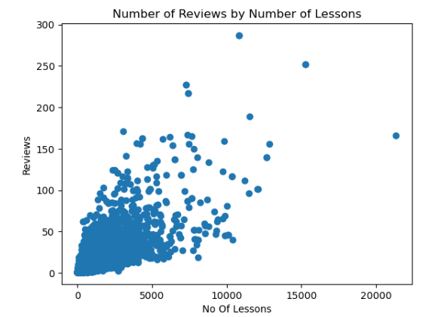
Graph #2
The graph depicting the number of reviews by the number of lessons shows a clear linear relationship. As the number of lessons increases, there is a proportional increase in the number of reviews. This suggests a strong correlation between the two variables, indicating that students who have more lessons tend to provide more feedback or reviews.

Slide 14
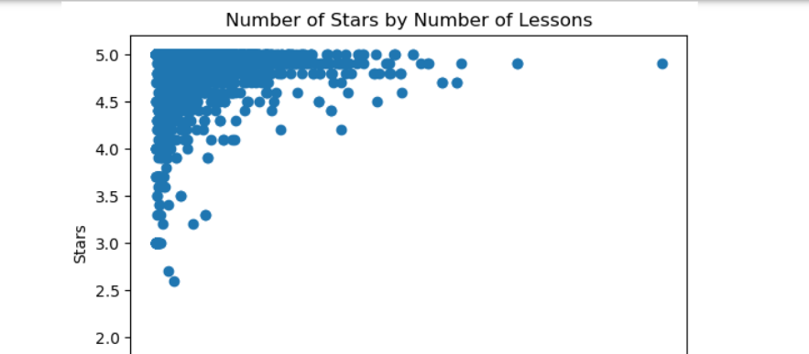
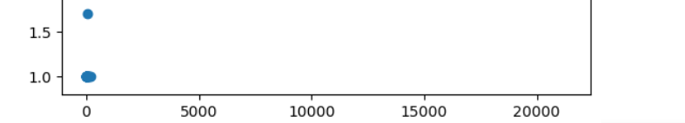
Graph #3
The graph illustrating the number of reviews by the number of lessons taught reveals an interesting observation. Regardless of the number of lessons taught, the majority of teachers received ratings above 3.5 stars. This suggests that the quality of teaching, as perceived by students and reflected in their reviews, remains consistently high, irrespective of the quantity of lessons delivered

Slide 15
Deciding to create a new column
During the exploratory data analysis (EDA) in step 3, we discovered an anomaly in the ratio between the star ratings, number of reviews, and the overall popularity of teachers. To rectify this issue, we returned to step 2 and introduced a customized logarithmic decimal base calculation.
The formula: Popularity Score=Stars*log10(Reviews)
This calculation involves taking the logarithm (base 10) of the number of reviews and multiplying it by the corresponding star ratings. The intention behind this calculation is to adjust the impact of reviews based on their logarithmic scale. By applying this transformation, we aim to achieve a more balanced and meaningful representation of a teacher's popularity, accounting for the relative significance of both star ratings and the logarithmically scaled number of reviews.

Slide 16
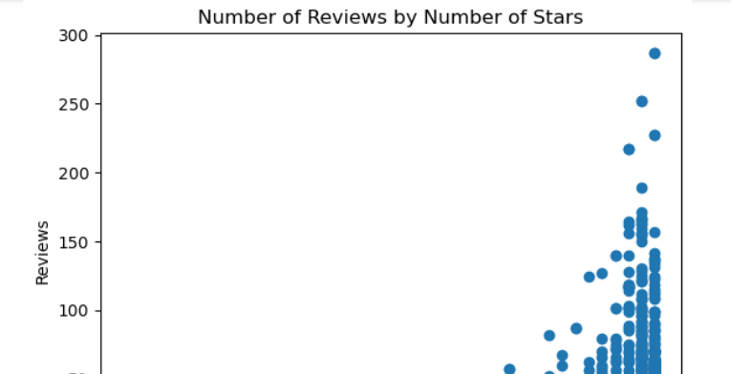
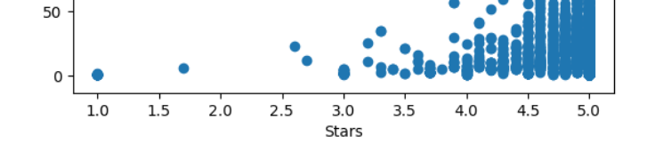
Graph #4

Slide 17
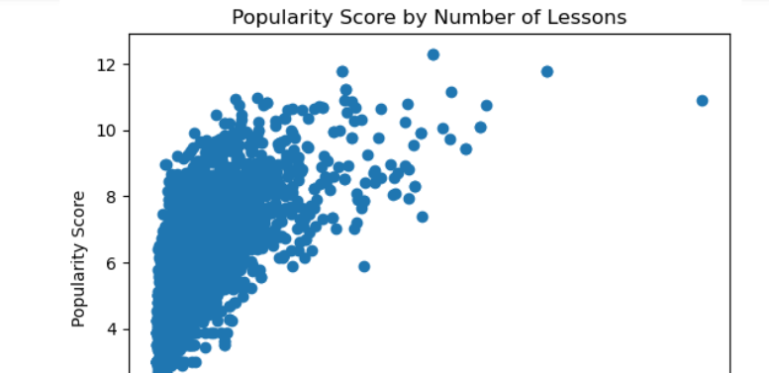
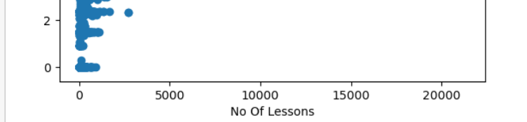
Graph #5
The graph illustrating the relationship between the "Popularity Score" and the number of lessons demonstrates the impact of the newly created column

Slide 18
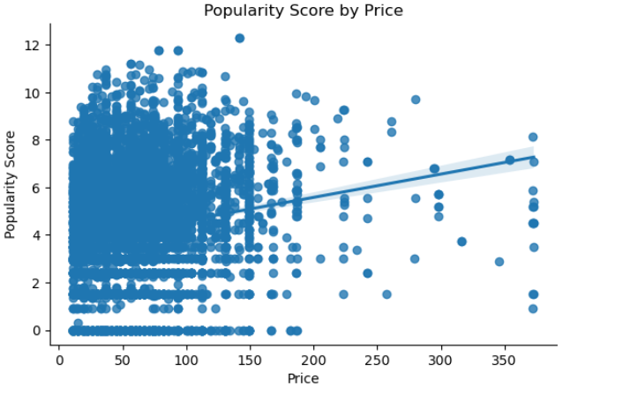
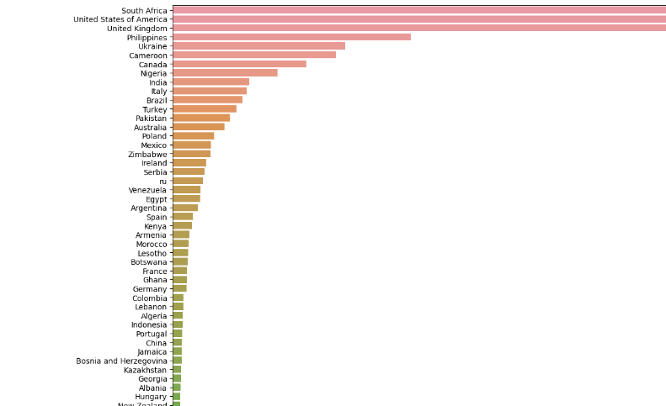
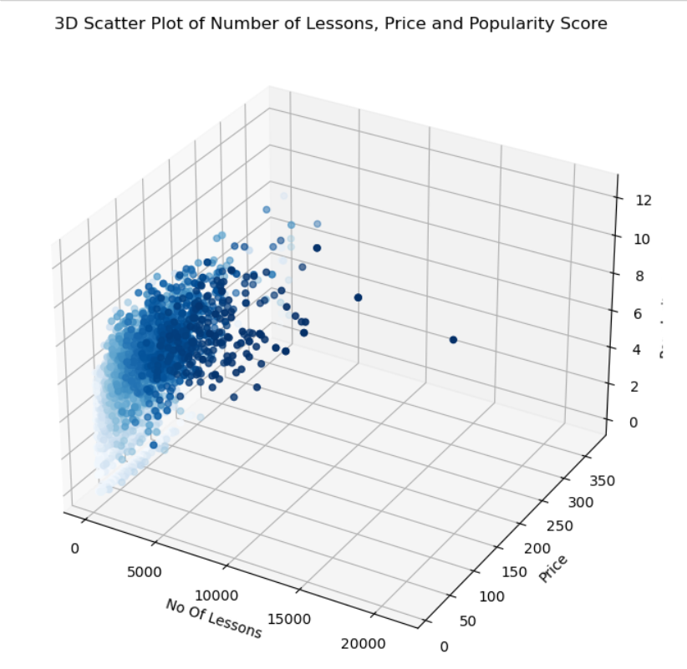
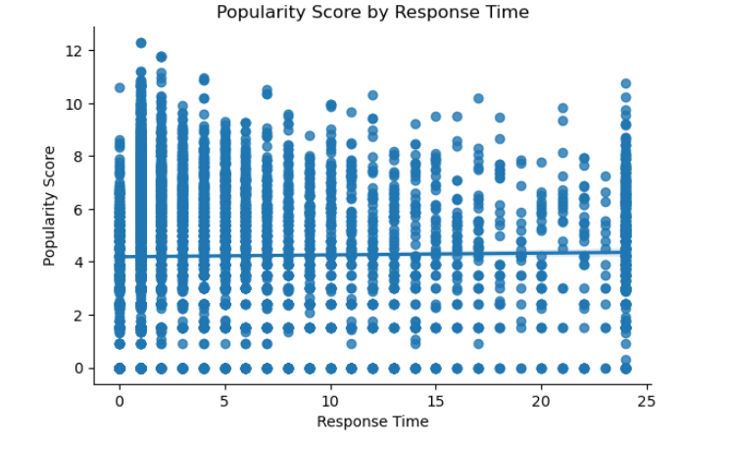
More Graphs - visualization

Slide 19
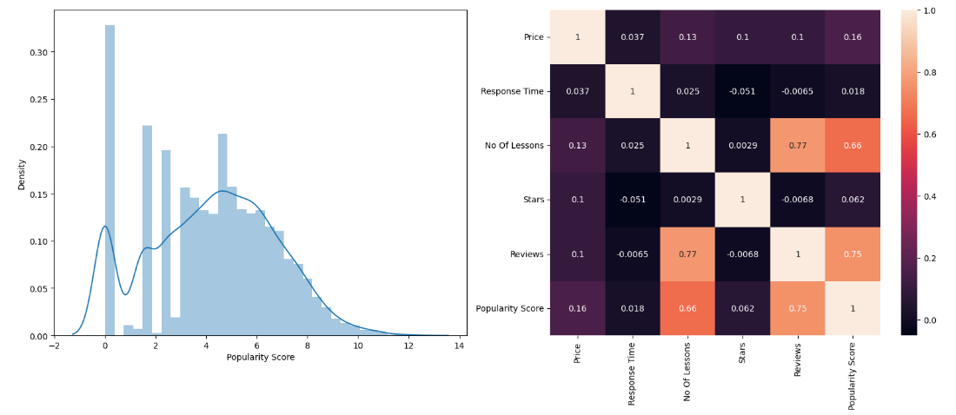
heatmap
Upon analyzing the heatmap, we observe a strong positive correlation between the popularity score and the number of lessons taught
However, in contrast to this significant correlation, we observe little to no correlation between the other variables in the dataset. This indicates that variables such as English level, price, and response time do not exhibit a strong linear relationship with the popularity score or with each other.

Slide 20
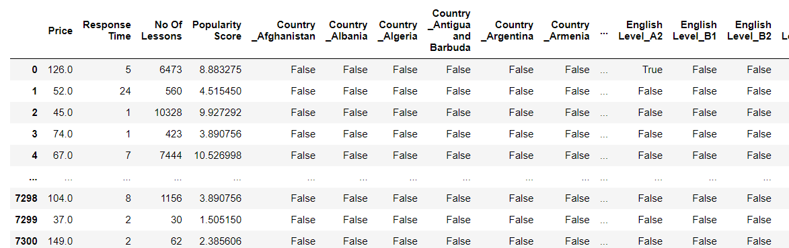
Advanced Data Analysis
we have made the decision to drop the columns of Stars and Reviews from our dataset. This decision was influenced by the calculations performed in step 2, which indicated a need to remove these columns to avoid bias in the data.
pd.get_dummies - The code utilizes one-hot encoding to transform categorical variables in the DataFrame into binary columns. This transformation allows the categorical variables to be interpreted as numerical features, providing a format that can be easily understood and processed by machine learning models

Slide 21
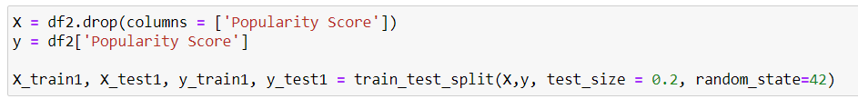
Machine learning
Creating the X and Y data for the ML

Slide 22
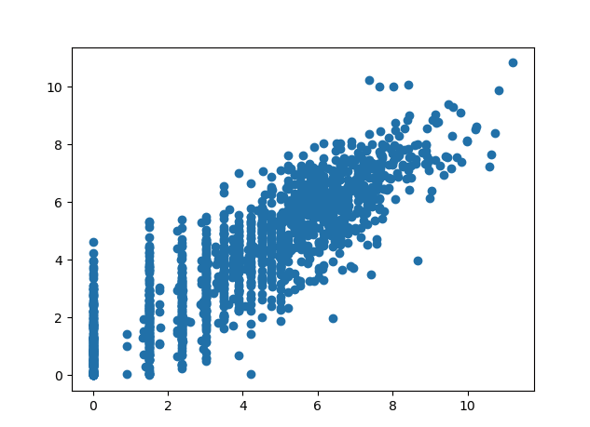
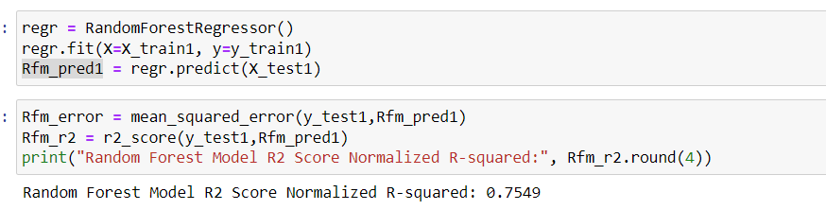
Random Forest Model
The Random Forest model is a machine learning algorithm that belongs to the ensemble learning category. It combines multiple decision trees to make predictions.
In a Random Forest, each decision tree is trained on a different subset of the data and uses a random selection of features. During the training process, the decision trees collectively make predictions, and the final prediction is determined by averaging or voting among the predictions of individual trees.

Slide 23
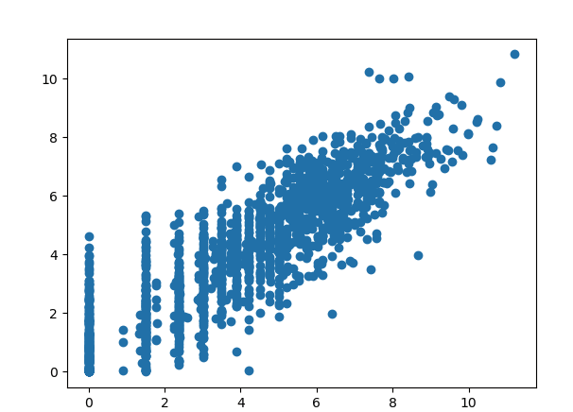
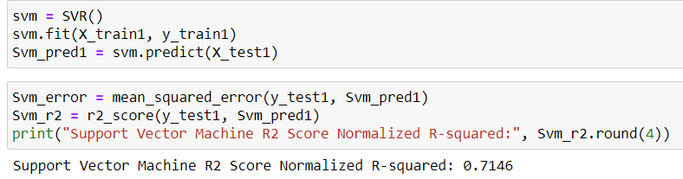
SVM Model
SVM (Support Vector Machine) is a powerful supervised machine learning algorithm used for both regression and classification tasks.
It works by creating a hyperplane or a set of hyperplanes in a high-dimensional feature space that separates different classes or maximizes the margin between data points.
SVM is particularly effective in scenarios where the data is not linearly separable. It achieves this by transforming the data into a higher-dimensional space using a kernel function, allowing for more complex decision boundaries

Slide 24
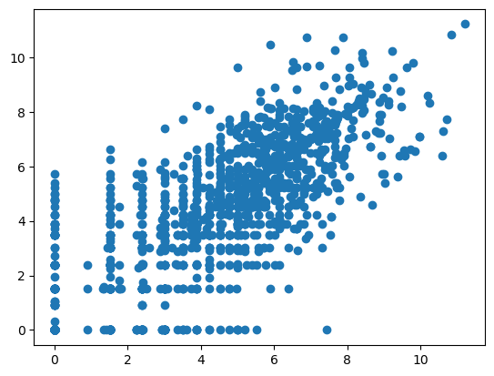
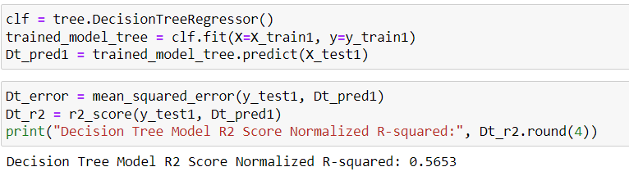
Decision Tree Model:
A decision tree is a supervised machine learning algorithm that uses a hierarchical structure of decision rules to make predictions or classifications. It represents a flowchart-like structure, where each internal node represents a decision based on a feature, and each leaf node represents an outcome or prediction.
The decision tree algorithm learns from the data by recursively splitting the dataset based on the values of different features, aiming to maximize the homogeneity or purity of each resulting subset. This splitting process continues until a stopping criterion is met, such as reaching a maximum depth or having a minimum number of samples in each leaf node.

Slide 25
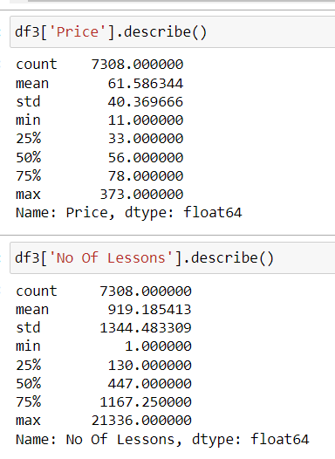
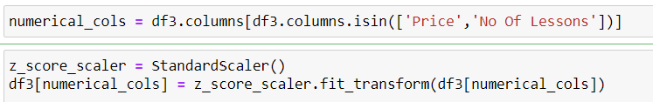
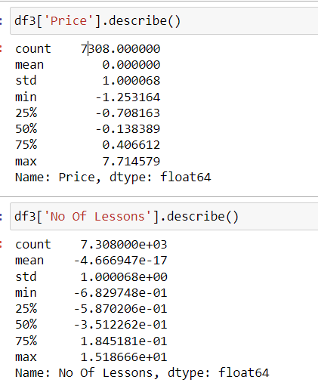
Attempts to improve the model
To enhance the model's performance, we attempted to improve the score results by scaling the data. Scaling is a common preprocessing step that aims to standardize the range of feature values.
By scaling the data, we aimed to bring all features to a similar scale, which can help prevent certain features from dominating the model's learning process
After observing the descriptive statistics of the "price" and "number of lessons" columns, we noticed a significant disparity between the average, minimum, maximum, and mean values. To address this discrepancy and ensure that these features are on a comparable scale, we made the decision to scale them.

Slide 26
After scaling
After scaling the data, we retrained the model and evaluated its performance to assess if there was any improvement in the score results.
Unfortunately, despite our efforts, we did not observe any significant improvement in the model's performance
Random Forest Model R2 Score
Normalizd -Rsquared: 0.7522
Support Vector Machine R2 Score Normalized R-squared: 0.588
Decision Tree Model R2 Score
Normalized R-squared: 0.575

Slide 27
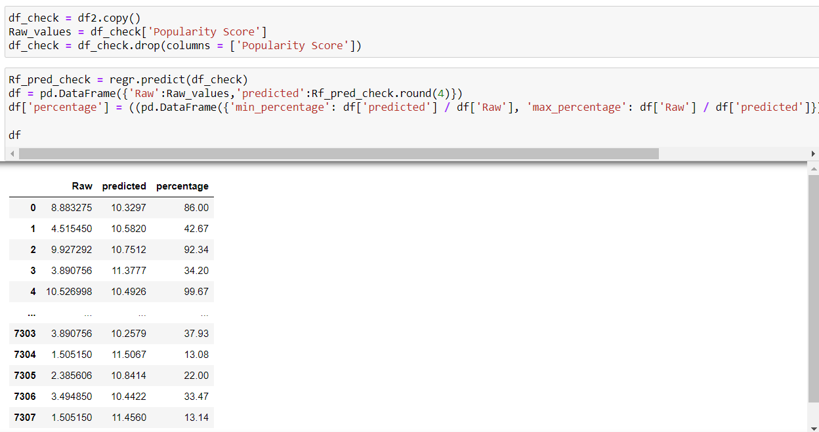
Checking the machine
In this table, we can observe the predictions made by the machine learning model alongside the true values. It provides a comprehensive overview of how well the model performed in predicting the target variable

Slide 28
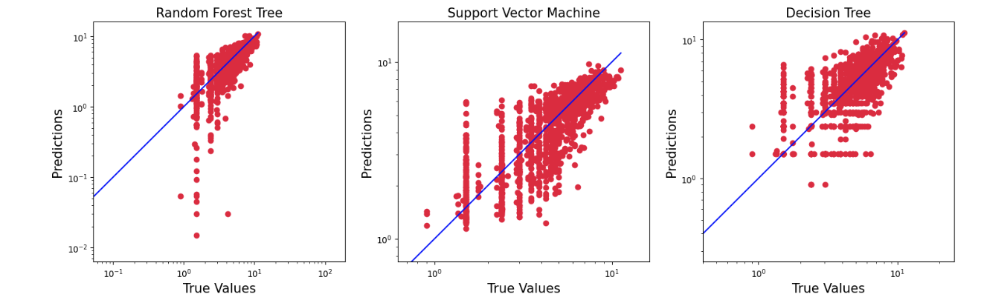
Checking the machine
The graph illustrates the distribution of all the values in our dataset in comparison to the model's predictions. The graph provides a visual representation of the data.
The scatter plots show the relationship between the true values (y_test1) and the predicted values (Rfm_pred1, Svm_pred1, Dt_pred1) for each model. The x-axis and y-axis are both displayed on a logarithmic scale. The blue line represents a perfect prediction, where the true values and predicted values are equal.

Slide 29
Conclusions
In conclusion, our research demonstrates that it is possible to predict the popularity of English tutors on the Preply platform with a high success rate (above 75%)
Feature Importance: Through our analysis, we determined that the "Number of Lessons" was the most influential feature in predicting the popularity of English tutors
Surprisingly, the "Price" and "Response Time" columns did not exhibit a strong correlation with the target column, contrary to our initial expectations.
ML Performance: Among the algorithms we experimented with, the Random Forest model yielded the highest R2 score
Importance of Data Preprocessing: Data preprocessing steps ensure that the data is appropriately prepared and can be effectively utilized by the algorithms
Further Exploration: While our analysis focused on the specific task of predicting popularity on the Preply platform, there are opportunities for further exploration and research
This project has been challenging and enlightening, providing valuable insights into data science. We gained a deeper understanding of data preprocessing, feature engineering, exploratory data analysis, model evaluation, and machine learning techniques. We look forward to applying these skills to future projects and expanding our knowledge in this domain.

Slide 30
Thank you for watching

